Slide 1

Phishing email detection

Slide 2

INTRoduction

Slide 3

https://www.itpro.co.uk/phishing/34561/thomas-cook-phishing-sites-skyrocket-following-firms-collapse

Slide 4
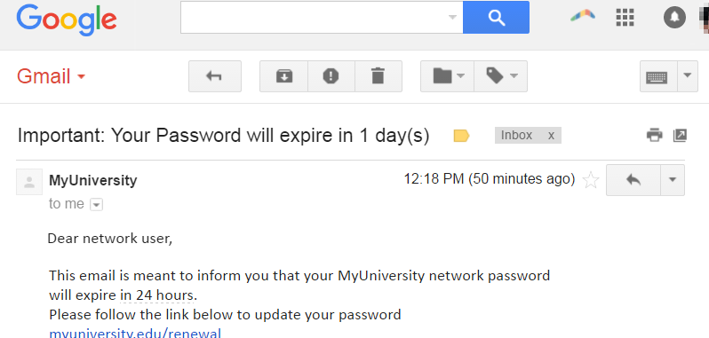
https://www.imperva.com/learn/application-security/phishing-attack-scam/

Slide 5
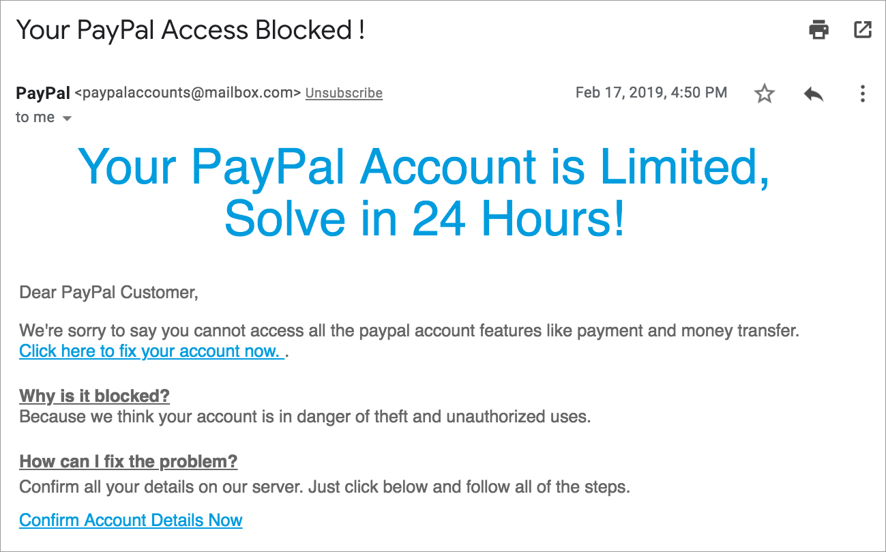
https://www.khanacademy.org/computing/computers-and-internet/xcae6f4a7ff015e7d:online-data-security/xcae6f4a7ff015e7d:cyber-attacks/a/phishing-attacks

Slide 6
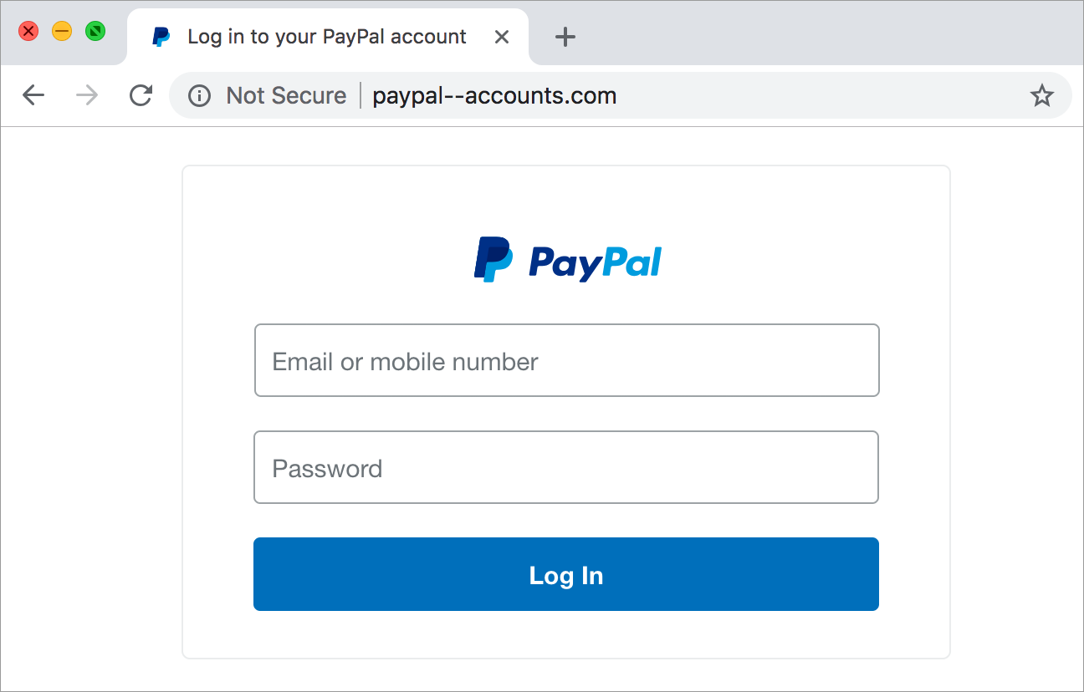
https://www.khanacademy.org/computing/computers-and-internet/xcae6f4a7ff015e7d:online-data-security/xcae6f4a7ff015e7d:cyber-attacks/a/phishing-attacks

Slide 8

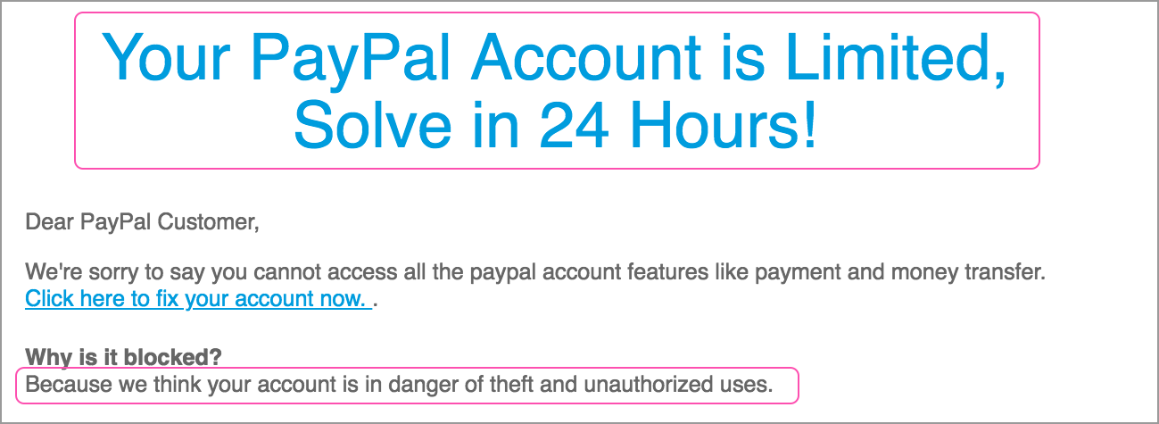
https://www.khanacademy.org/computing/computers-and-internet/xcae6f4a7ff015e7d:online-data-security/xcae6f4a7ff015e7d:cyber-attacks/a/phishing-attacks

Slide 9
https://www.khanacademy.org/computing/computers-and-internet/xcae6f4a7ff015e7d:online-data-security/xcae6f4a7ff015e7d:cyber-attacks/a/phishing-attacks

Slide 10

METHOD

Slide 11
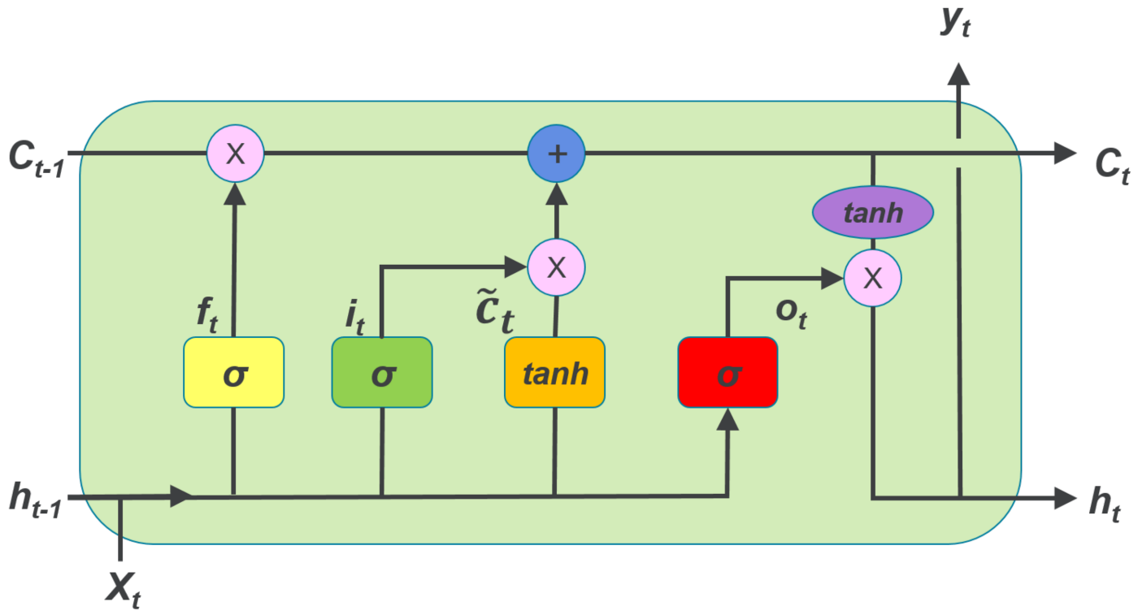
Long Short-Term Memory (LSTM)

Slide 12
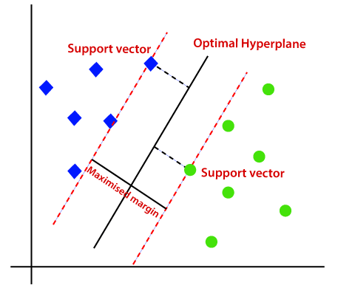
Support Vector Machine (SVM)

Slide 13

RESULT

Slide 14

DEMO

Slide 15
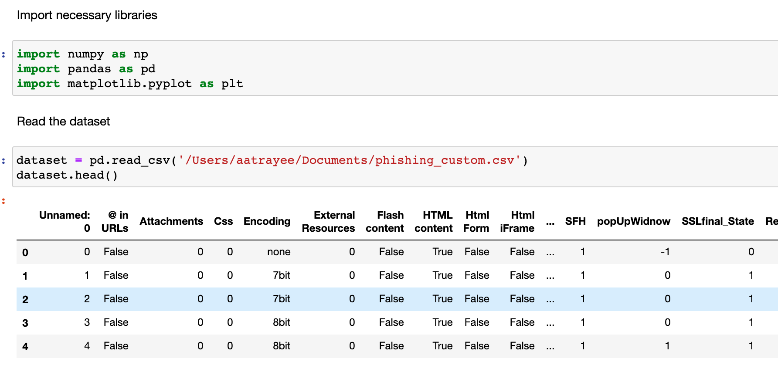

Slide 16
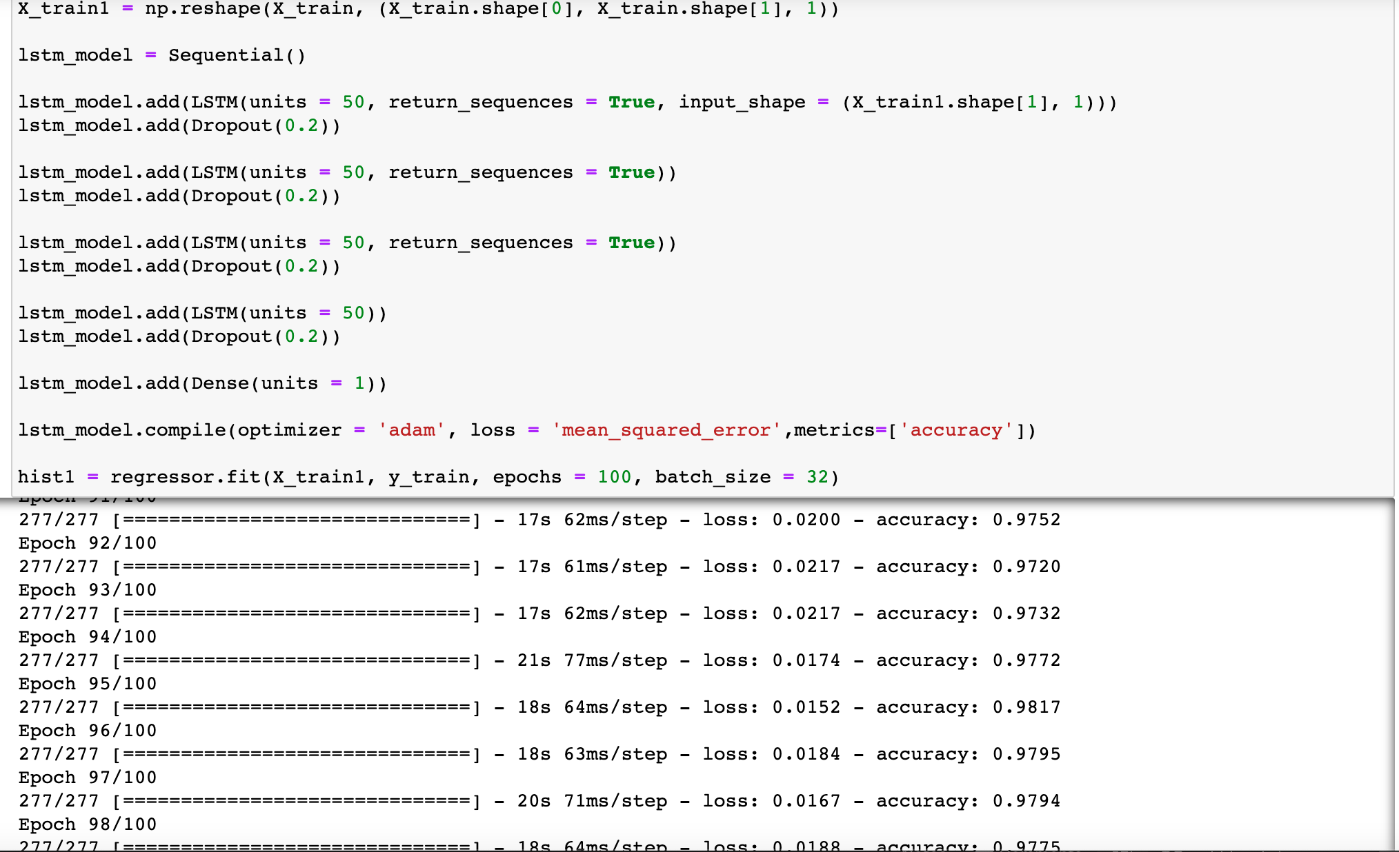

Slide 17
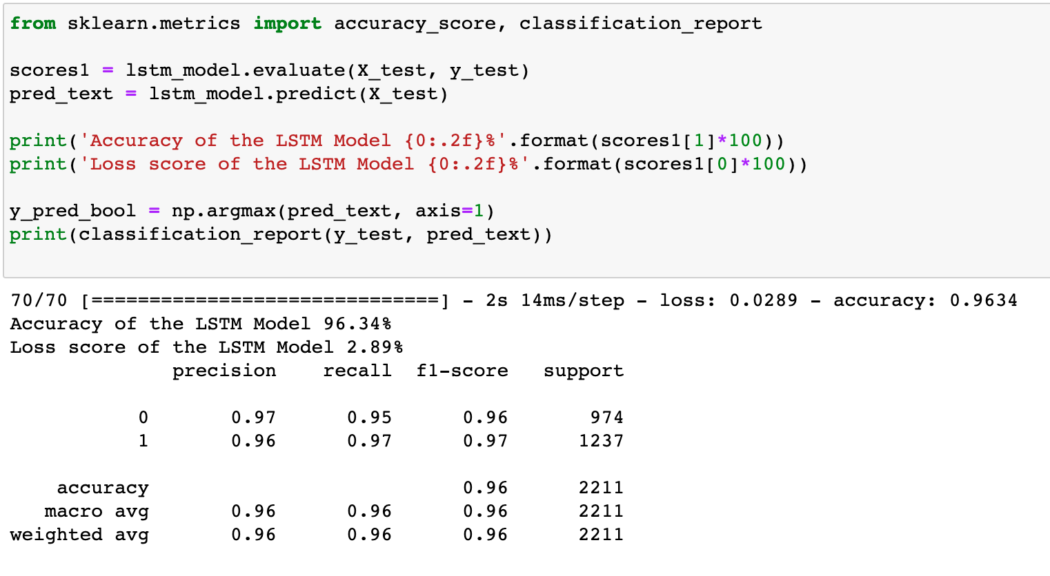

Slide 18
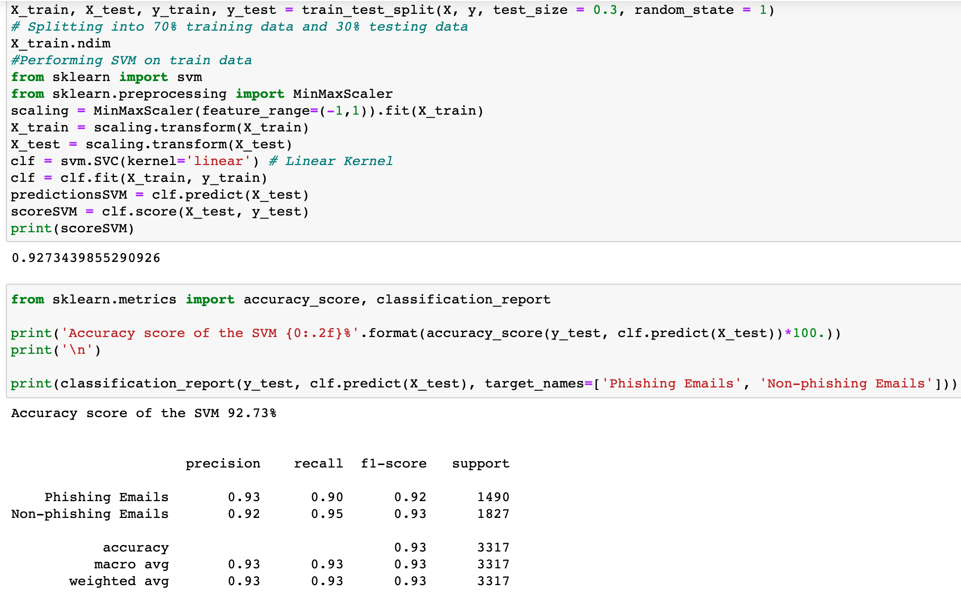

Slide 19

CHALLENGES

Slide 20

PERFORMANCE ANALYSIS

Slide 21
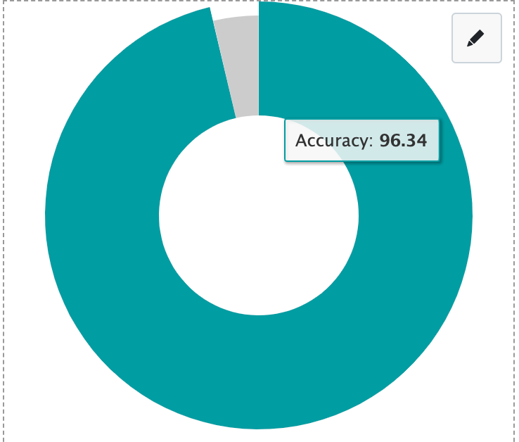
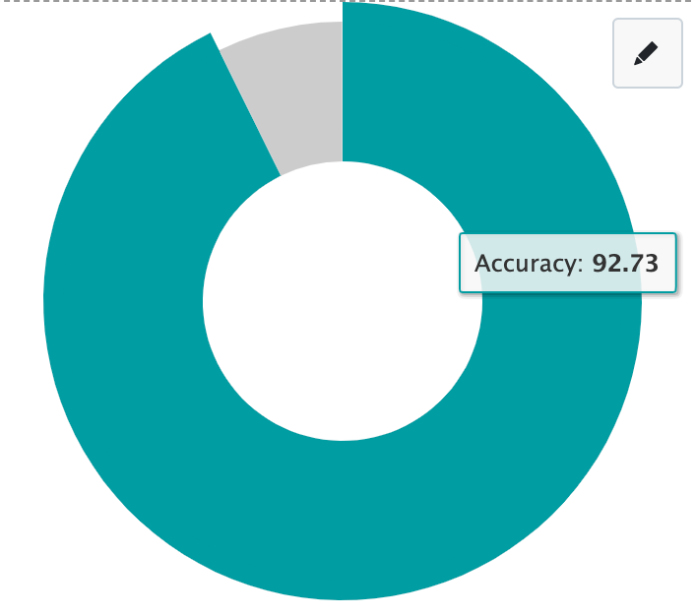
ACCURACY
LSTM
SVM

Slide 22
Phishing emails | Precision | Recall
LSTM | 97% | 95%
SVM | 93% | 90%
Non-phishing emails | Precision | Recall
LSTM | 96% | 97%
SVM | 92% | 95%

Slide 23

Thank you

